Slide 1
AP Statistics
Day One
Syllabus
AP Content Outline
Estimating Populations and Subpopulations

Slide 2
Learning Targets:
I can listen and ask questions while going over the syllabus.
I can listen and ask questions while going over the AP Content for Statistics.

Slide 3
AP STATISTICS
Introduction
Vocabulary
Graphs

Slide 4
Learning Targets:
I can define the critical vocabulary for Chapter One of Statistics (see handout).
I can classify data as categorical or quantitative.
I can create a bar graph, a pie chart, a dot plot, and a stem plot and know when to use which kind of graph.

Slide 5
Vocabulary
Individuals are the objects described by a set of data. Individuals may be people, but they may also be animals or things.
A variable is any characteristic of an individual. A variable can take different values for different individuals.
Example: A college student’s data base includes data about every currently enrolled student. The students are the individuals described by the data set. For each individual, the data contain the values of variables such as age, gender, choice of major, and grade point average.

Slide 6
Questions you should ask yourself when you meet a new set of data
Who? What individuals do the data describe? How many individuals appear in the data?
What? How many variables are there? What are the exact definitions of these variables? In what units is each variable recorded? Is there any reason to mistrust the values of any variable?
Why? What is the reason the data were gathered? Do we hope to answer some specific questions? Do we want to draw conclusions about individuals other than the ones we actually have data for?

Slide 7
A categorical variable places an individual into one of several groups or categories.
A quantitative variable takes numerical values for which arithmetic operations such as adding and averaging make sense.
The types of graphs and numerical summaries we should choose depend on the types of variables we are examining.

Slide 8
Types of graphs we should choose
Variable | Graphical Displays | Numerical Summaries
Categorical | Pie Charts, Bar Graphs | Counts, percents, proportions
Quantitative | Dotplots, stemplots, histograms | Center: mean, median, mode; Spread: range, standard deviation, interquartile range
There are some numerical values that are not quantitative. Can you think of some?

Slide 9
How to Construct a Bar Graph
Step 1: Label your axes and title your graph. Draw a set of axes. Label the horizontal axis and vertical axes. Title your graph.
Step 2: Scale your axes. Use the counts in each category to help you scale your vertical axes. Write the category names at equally spaced intervals beneath the horizontal axis.
Step 3: Draw a vertical bar above each category name to a height that corresponds to the count in that category. Leave a space between the bars in a bar graph.

Slide 10
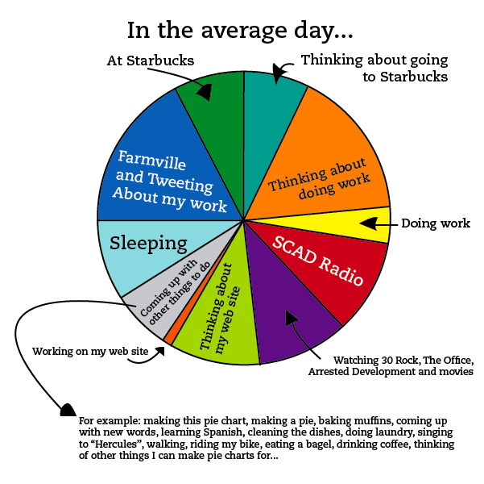
How to Construct a Pie Chart
Step 1: Create a frequency table.
Step 2: Calculate the relative frequency for each category.
Step 3: Multiply the relative frequency for each category by 360˚. This number represents the number of degrees that “piece of pie” is.
Step 4: Draw a circle. Using the center construct each piece using the degrees found above.

Slide 11
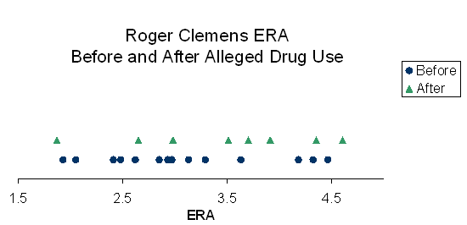
How to Construct a Dotplot
Step 1: Label your axis and title your graph. Draw a horizontal line and label it with the variable.
Step 2: Scale the axis based on the values of the variable.
Step 3: Mark a dot above the number on the horizontal axis corresponding to each data value.

Slide 12
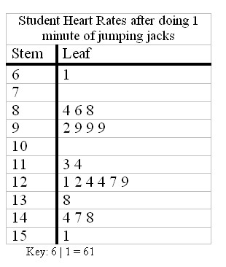
How to Construct a Stemplot
Step 1: Separate each observation into
a stem consisting of all but the right-
most digit and a leaf, the final digit.
Step 2: Write the stems vertically in
increasing order from top to bottom,
and draw a vertical line to the right of
the stems. Go through the data,
Writing each leaf to the right of its
stem and spacing the leaves equally.
Step 3: Write the stems again, and rearrange the leaves in increasing order out from the stem.
Step 4: Title your graph and add a key describing what the stems and leaves represent.

Slide 13
The purpose of the graph is to help us understand the data. After you make the graph, always ask yourself, “What do I see?”. Look for an overall pattern and also striking deviations from that pattern.
Remember “SOCS”
S— Shape of the distribution
O- Outliers
C- Center
S- Spread

Slide 14
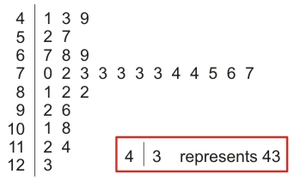
Describe the shape, outliers, center, and spread of the stem plot.

Slide 15
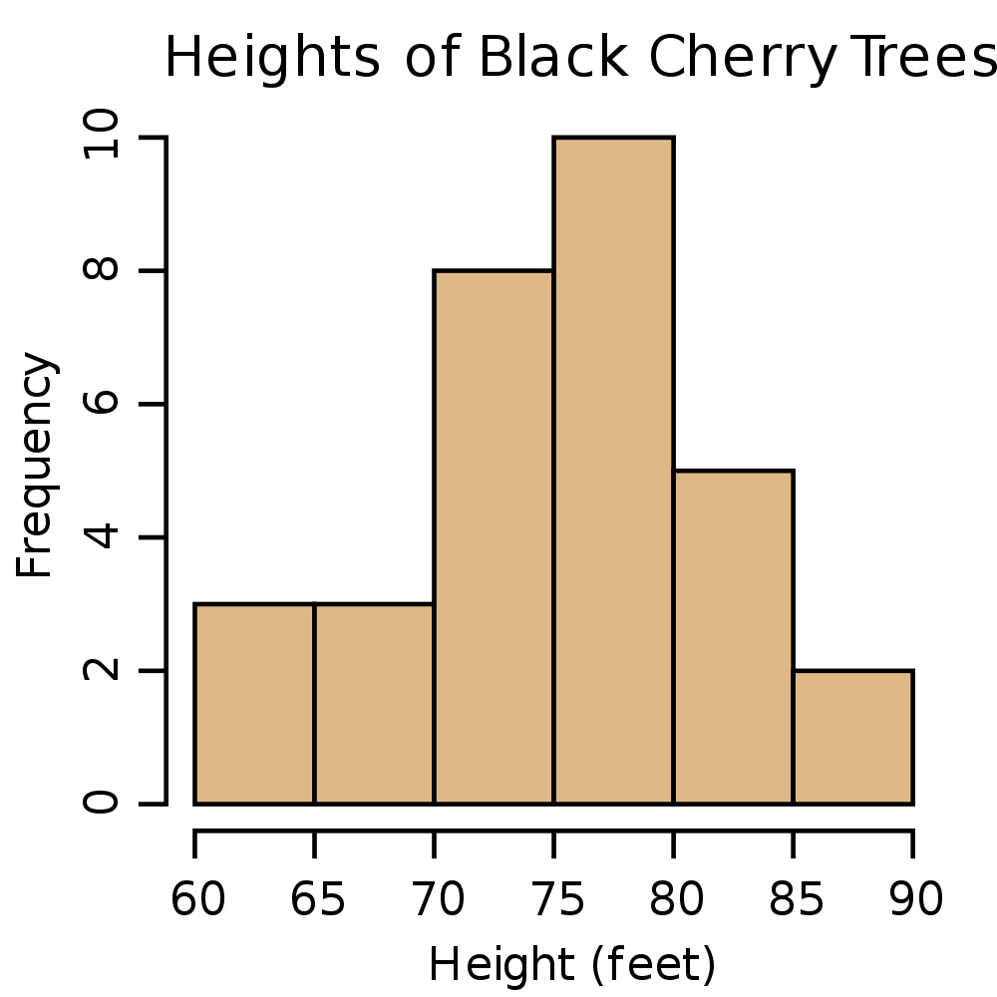
Quantitative variables often take many values. A graph of the distribution is clearer if nearby values are grouped together. The most common graph of the distribution of one quantitative variable is a histogram.

Slide 16
How to Make a Histogram
Step 1: Divide the range of the data into classes of equal width. Count the number of observations in each class. Be sure to specify the classes precisely so that each observation falls into exactly one class.
Step 2: Label and scale your axes and title your graph.
Step 3: Draw a bar that represents the count in each class. The base of the bar should cover its class, and the bar height is the class count. Leave no horizontal space between the bars, unless one class is empty.

Slide 17
Histogram Tips
There is no one right choice of the classes in a histogram. Too few classes will give a “skyscraper” appearance and too many will give a “pancake” appearance.
Five classes is a good minimum.
Our eyes respond to the area of the bars in a histogram, so be sure to choose classes that are all the same width. Then area is determined by height and all classes are fairly represented.
If you use a computer or graphing calculator, beware of letting the device choose the class.

Slide 18
(a) Find the class width.
(b) Make a frequency table showing class limits, class boundaries, midpoint, frequencies, relative frequencies.
(c) Draw a histogram.
(d) Draw a relative-frequency histogram.

Slide 19
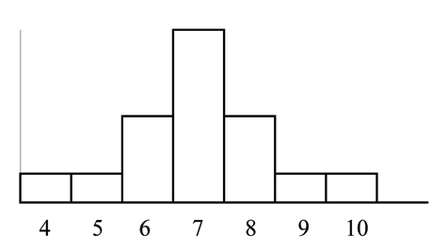
More About Shape
A distribution is symmetric if the right and left sides of the histogram are approximately mirror images of each other.

Slide 20
More About Shape
A distribution is skewed to the right if the right side of the histogram extends much farther out that the left side.

Slide 21
More About Shape
A distribution is skewed to the left if the left side of the histogram extends much farther out that the right side.

Slide 22
Relative Frequency, Cumulative Frequency, Percentiles, and Ogives
Percentile
The pth percentile of a distribution is the value such that p percent of the observations fall at or below it.
Example)
You receive the results of your standardized test which reports you were in the 80th percentile in math. What does this mean?

Slide 23
Relative Frequency, Cumulative Frequency, Percentiles, and Ogives

Slide 24
Relative Frequency, Cumulative Frequency, Percentiles, and Ogives
5 | 8 | 10 | 14 | 18 | 22 | 26 | 30 | 35 | 35
37 | 38 | 40 | 41 | 41 | 41 | 43 | 45 | 45 | 47
Find the following percentiles:
10th
25th
75th
4. What percentile is 41?

Slide 25
Relative Frequency, Cumulative Frequency, Percentiles, and Ogives
Finding the Percentile that Corresponds to a Data Value
1. Arrange the data in ascending order.
Use the following formula to determine the percentile of the score, x:
$$Percentile of x= \frac{number of data values less than x}{total number of values } times 100$$
3. Round this number to the nearest integer.

Slide 26
Relative Frequency, Cumulative Frequency, Percentiles, and Ogives
A histogram does a good job of displaying the distribution of values of a variable. But it tells us little about the relative standing of an individual observation. If we want this type of information, we should construct a relative cumulative frequency graph, often called an ogive (pronounced o-jive).

Slide 27
How to Construct an Ogive
Step 1. Decide on class intervals and make a frequency table, just as in making a histogram. Add three columns to your frequency table: relative frequency, cumulative frequency, and relative cumulative frequency.
Class | Frequency | Relative frequency | Cumulative frequency | Relative cumulative frequency

Slide 28
Step 2. Label and scale your axes and title your graph. Scale the horizontal axis according to your choice of class intervals and the vertical axis from 0% to 100%.
Step 3. Plot a point corresponding to the relative cumulative frequency in each class interval at the left endpoint of the next class interval. Begin your ogive with a point at height 0% at the left endpoint of the lowest class interval. Connect consecutive points with a line segment to form the ogive. The last point you should be at a height of 100%.

Slide 29
Relative Frequency, Cumulative Frequency, Percentiles, and Ogives
How to locate an individual within the distribution (page 29)
How to locate a value corresponding to a percentile (page 29)

Slide 30
Time Plots
A time plot of a variable plots each observation against the time at which it was measured. Always mark the time scale on the horizontal axis and the variable of interest on the vertical axis. If there are too many points, connecting the points by lines helps show the pattern of changes over time.
When you are examining a time plot, look for an overall pattern and strong deviations from the pattern. One common overall pattern is a trend, a long-term upward or downward movement across time. A pattern that repeats itself at regular intervals is known as a seasonal variation.

Slide 31
