Slide 1
Section 1.2
Describing Distributions with Numbers

Slide 2
Describing Distributions with Numbers
A parameter is a descriptive measure of a population.
A statistic is a descriptive measure of a sample.
A statistic is an unbiased estimator of a parameter if it does not consistently over- or underestimate the parameter.

Slide 3
Describing Distributions with Numbers
Measures of Central Tendency
The arithmetic mean of a variable is computed by determining the sum of all the values of the variable in the data set divided by the number of observations.

Slide 4
Describing Distributions with Numbers
The population arithmetic mean, is computed using all the individuals in a population.
The population mean is a parameter.
The population arithmetic mean is denoted by $μ$

Slide 5
Describing Distributions with Numbers
The sample arithmetic mean, is computed using sample data.
The sample mean is a statistic that is an unbiased estimator of the population mean.
The sample arithmetic mean is denoted by $\overline{x}$

Slide 6
Describing Distributions with Numbers

Slide 7
Describing Distributions with Numbers
Measures of Central Tendency
The median of a variable is the value that lies in the middle of the data when arranged in ascending order. That is, half the data is below the median and half the data is above the median. We use M to represent the median.

Slide 8
Describing Distributions with Numbers

Slide 9
Describing Distributions with Numbers
Measures of Central Tendency
The mode of a variable is the most frequent observation of the variable that occurs in the data set.
If there is no observation that occurs with the most frequency, we say the data has no mode.

Slide 10
Describing Distributions with Numbers
The arithmetic mean is sensitive to extreme (very large or small) values in the data set, while the median is not. We say the median is resistant to extreme values, but the arithmetic mean is not.

Slide 11
Describing Distributions with Numbers
When data sets have unusually large or small values relative to the entire set of data or when the distribution of the data is skewed, the median is the preferred measure of central tendency over the arithmetic mean because it is more representative of the typical observation.

Slide 12
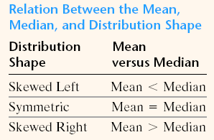
Describing Distributions with Numbers

Slide 13
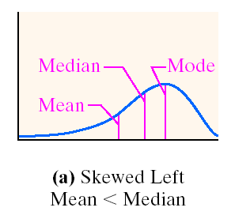
Describing Distributions with Numbers

Slide 14
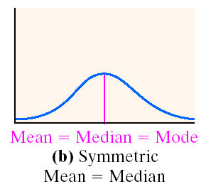
Describing Distributions with Numbers

Slide 15
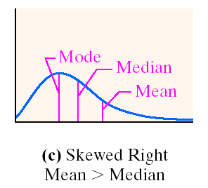
Describing Distributions with Numbers

Slide 16
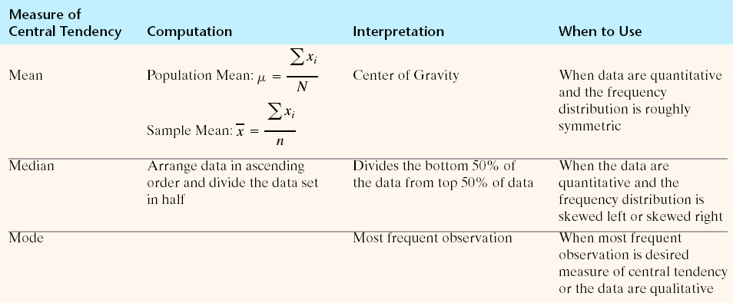
Describing Distributions with Numbers

Slide 17
Describing Distributions with Numbers
Measuring Spread:
The Five-Number Summary
MINIMUM Q₁ M Q₃ MAXIMUM
Interquartile Range = IQR = Q₃ - Q₁

Slide 18
Describing Distributions with Numbers
Steps for Drawing a Boxplot
Step 1: Determine the lower and upper fence: Lower Fence = Q₁ - 1.5(IQR)
Upper Fence = Q₃ + 1.5(IQR)
Step 2: Draw vertical lines at Q₁, M, and Q₃. Enclose these vertical lines in a box.
Step 3: Label the lower and upper fence.
Step 4: Draw a line from Q₁ to the smallest data value that is larger than the lower fence. Draw a line from Q₃ to the largest data value that is smaller than the upper fence.

Slide 19
Describing Distributions with Numbers
Example: Graph Hank Aaron’s homerun counts in a boxplot and describe the distribution. Remember SOCS!!!
Hank Aaron’s Homerun Counts
13 | 27 | 26 | 44 | 30 | 39 | 40 | 34
45 | 44 | 24 | 32 | 44 | 39 | 29 | 44
38 | 47 | 34 | 40 | 20

Slide 20
Describing Distributions with Numbers
Distribution Shape Based Upon Boxplot
1. If the median is near the center of the box and each of the horizontal lines are approximately equal length, then the distribution is roughly symmetric.
2. If the median is left of the center of the box and/or the right line is substantially longer than the left line, the distribution is right skewed.
3. If the median is right of the center of the box and/or the left line is substantially longer than the right line, the distribution is left skewed

Slide 21
Describing Distributions with Numbers
Symmetric

Slide 22
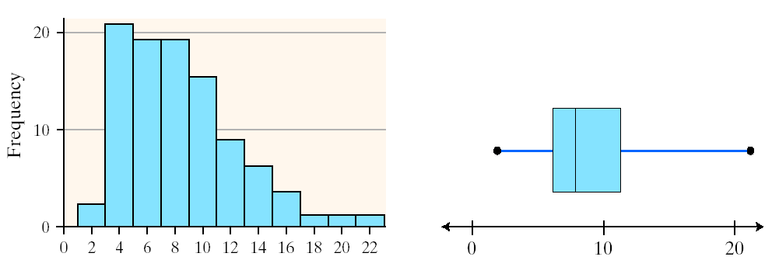
Describing Distributions with Numbers
Skewed Right

Slide 23
Describing Distributions with Numbers
Skewed Left

Slide 24
Describing Distributions with Numbers
A modified boxplot is a graph of the five-number summary, with outliers plotted individually.
A central box spans the quartiles.
A line in the box marks the median.
Observations more than 1.5 x IQR outside the central box are plotted individually.
Lines extend from the box out to the smallest and largest observations that are not outliers.

Slide 25
Describing Distributions with Numbers
Hank Aaron’s Homerun Counts
13 | 27 | 26 | 44 | 30 | 39 | 40 | 34
45 | 44 | 24 | 32 | 44 | 39 | 29 | 44
38 | 47 | 34 | 40 | 20
Enter the data below into L2 and create another boxplot on the same graph as before. Compare and contrast the two graphs describing the center, spread, shape, and outliers.
Barry Bond’s Homerun Counts
16 | 19 | 24 | 25 | 25 | 33 | 33 | 34
34 | 37 | 37 | 40 | 42 | 46 | 49 | 73

Slide 26
The range, R, of a variable is the difference between the largest data value and the smallest data values. That is
Range = R = Largest Data Value – Smallest Data Value

Slide 27
The population variance of a variable is the sum of squared deviations about the population mean divided by the number of observations in the population, N.
That is it is the arithmetic mean of the sum of the squared deviations about the population mean.

Slide 28
The population variance is symbolically represented by lower case Greek sigma squared.
Note: When using the above formula, do not round until the last computation. Use as many decimals as allowed by your calculator in order to avoid round off errors.

Slide 29
The sample variance is computed by determining the sum of squared deviations about the sample mean and then dividing this result by n – 1.
Note: Whenever a statistic consistently overestimates or underestimates a parameter, it is called biased. To obtain an unbiased estimate of the population variance, we divide the sum of the squared deviations about the mean by n - 1.

Slide 30
The population standard deviation is denoted by
It is obtained by taking the square root of the population variance, so that

Slide 31
L1 Values of X | L2 Mean of X $$\overline{x}$$ | L3 X – Mean X $$\left(x − \overline{x}\right)$$ | L4 (x – mean x)² ${(x − \overline{x})}^{2}$

Slide 32
Properties of the Standard Deviation
S measures the spread about the mean and should be used only when the mean is chosen as the measure of center.
S= 0 only when there is no spread. This happens only when all observations have the same value. Otherwise, s > 0. As the observations become more spread out about their mean, s gets larger.
S is not resistant. Strong skewness of a few outliers can make s very large.

Slide 33
Choosing a Spread
The five-number summary is usually better than the mean and standard deviation for describing a skewed distribution with strong outliers. Use the mean only for reasonably symmetric distributions that are free of outliers.

Slide 34
Changing the unit of measurement
Linear Transformation
A linear transformation changes the original variable x into the new variable x(new) given by an equation of the form
x (new) = a + bx
Adding a constant shifts the values of x upward or downward by the same amount.
Multiplying by the positive constant b changes the size of the unit of measurement.

Slide 35
Example) Grades on a test
The following represent grades on a test:
60, 72, 75, 80, 82, 82, 84, 85, 85, 85, 87, 88, 88
The teacher is going to curve the grades to ensure a student gets an A. She will need to add 4 points to each student’s grade.
x (new) = 4 + x

Slide 36
Example) Wrong unit of measurement
For a lab experiment students must measure the length of their armspan. Some of the students used feet as the measurement tool and others used inches. We want them to have the same unit of measure so that we may compare. We decide to change the unit of measure to inches. What do we need to do to the data?

Slide 37
Use the data about the test grades and calculate the following:
Mean of x, standard deviation of x
Mean of x (new), standard deviation of x (new)
Make up a data set and call it y. Multiply the data in set y to get y (new). Calculate the following:
Mean of y, standard deviation of y
Mean of y (new), standard deviation of y (new)

Slide 38
Effects of a Linear Transformation
To see the effect of a linear transformation on measures of center and spread, apply these rules:
Multiplying each observation by a positive number b multiplies both measures of center (mean and median) and measures of spread (standard deviation and IQR) by b.
Adding the same number a (either positive or negative) to each observation adds a to measures of center and to quartiles but does not change measures of spread.

Slide 39
Comparing Distributions
side by side bar graphs
back to back stem plots
side by side boxplots
When comparing two data sets, it is important to not just state the facts, but provide some actual comparison statement using larger, smaller, wider, or less skewed as examples.
“Distribution A is centered at 6 whereas distribution B is centered near 4. Sind the mean in set B is lower than the mean in set A, set B would tend to have lower overall values, on average than set A.”

