Slide 1
Section 2.1
Density Curves and
the Normal Distribution

Slide 2
Density Curves and the Normal Distributions
The curve is a mathematical model for the distribution. A mathematical model is an idealized description. It gives a compact picture of the overall pattern of the data but ignores minor irregularities as well as outliers.
We will see that it is easier to work with a smooth curve than with a histogram. The reason is that the histogram depends on our choice of classes, while with a little care we can use a curve that does not depend on any choices we make.

Slide 3
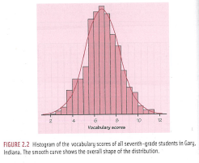
Density Curves and the Normal Distributions
Figure 2.2 on page 78

Slide 4
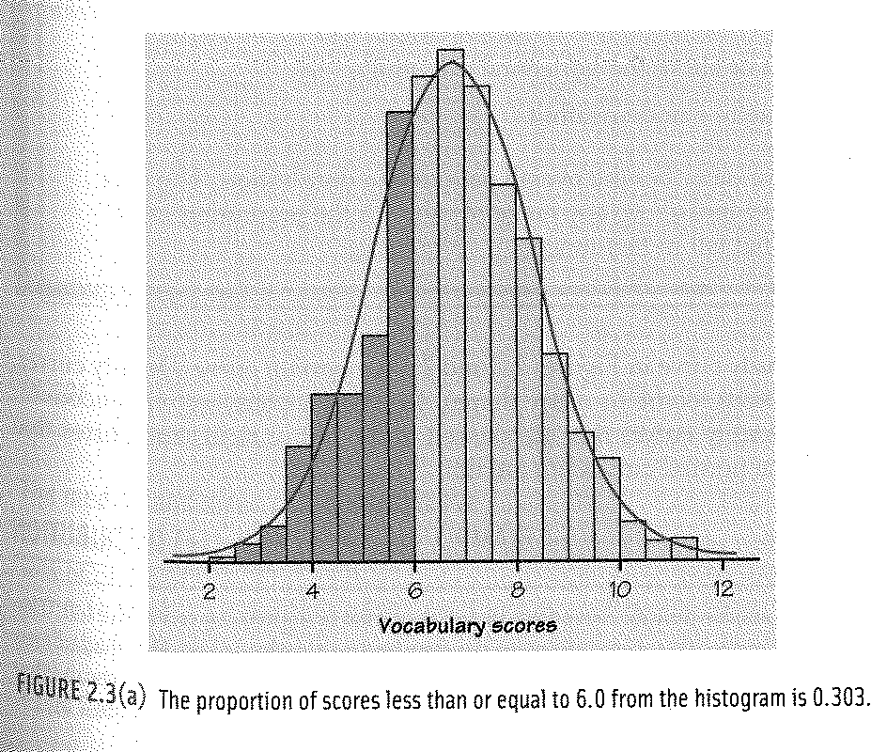
Density Curves and the Normal Distributions
Figure 2.3 a page 79

Slide 5
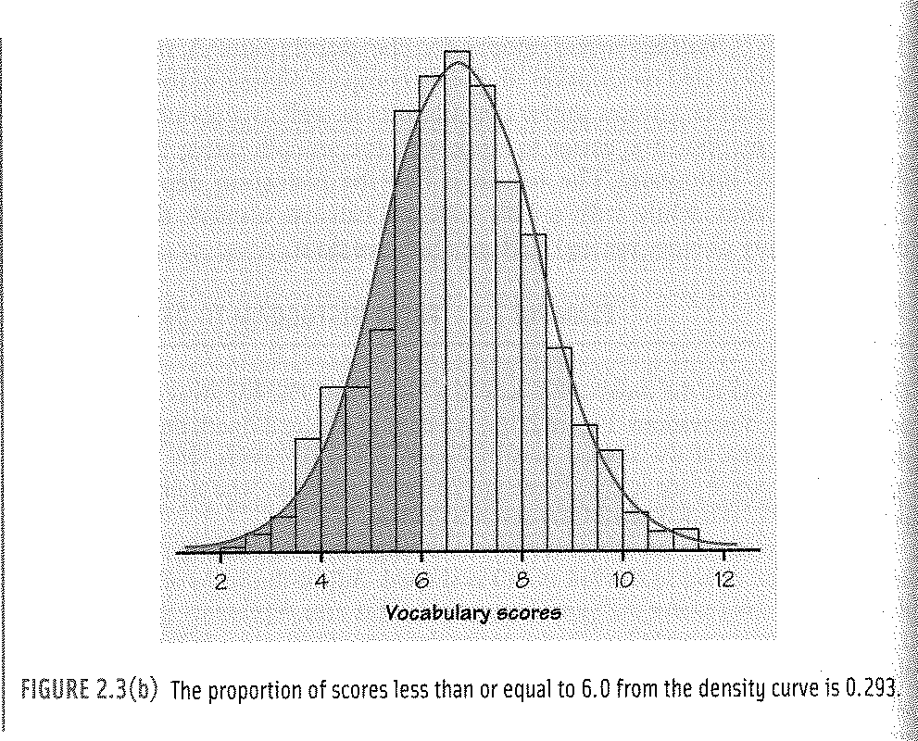
Density Curves and the Normal Distributions
Figure 2.3 b page 80

Slide 6
Density Curves and the Normal Distributions
Density Curve
A density curve is a curve that
is always on or above the horizontal axis, and
has area exactly 1 underneath it.
A density curve describes the overall pattern of a distribution. The area under the curve and above the range of values is the proportion of all observations that fall in that range.
Figure 2.3 a and 2.3 b are normal curves.

Slide 7
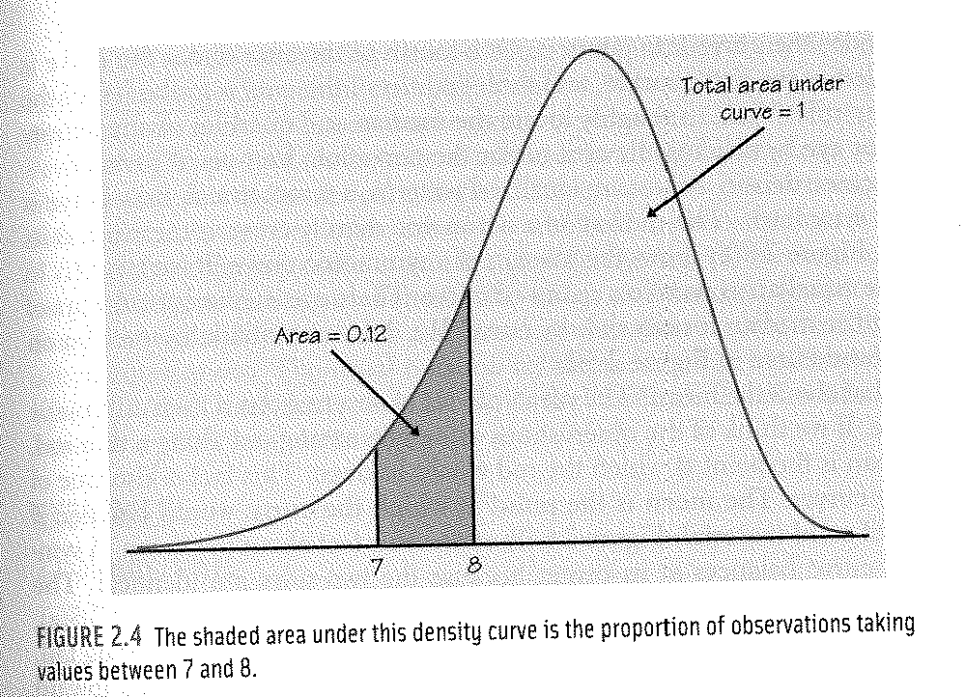
Density Curves and the Normal Distributions

Slide 8
Density Curves and the Normal Distributions
The median and mean of a density curve
Our measures of center and spread apply to density curves as well as to actual sets of observations. The median and quartiles are easy. Areas under the density curve represent proportions of the total number of observations. The median is the point half the observations on either side. So the median of a density curve is the equal-areas point, the point with half of the area under the curve to the left and the other half to the right. Similarly, the quartiles break the curve into quarters, each is ¼ (25%) of the area under the curve

Slide 9
Density Curves and the Normal Distributions
What about the mean? The mean of a set of observations is their arithmetic average. If we think of the observations as weights strung out along a thin rod, the mean is the point at which the rod would balance. If we look at a density curve as a solid object, the mean is the point at which the curve would balance. The mean and median of a symmetric density curve are equal. The mean of a skewed curve is pulled from the median in the direction of the long tail.

Slide 10
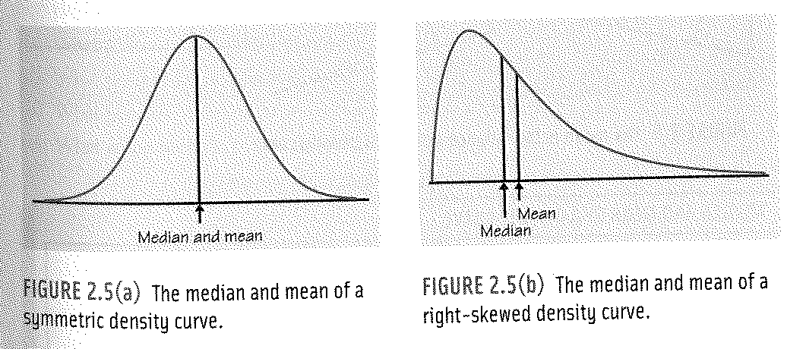
Density Curves and the Normal Distributions

Slide 11
Density Curves and the Normal Distributions

Slide 12
Density Curves and the Normal Distributions

Slide 13
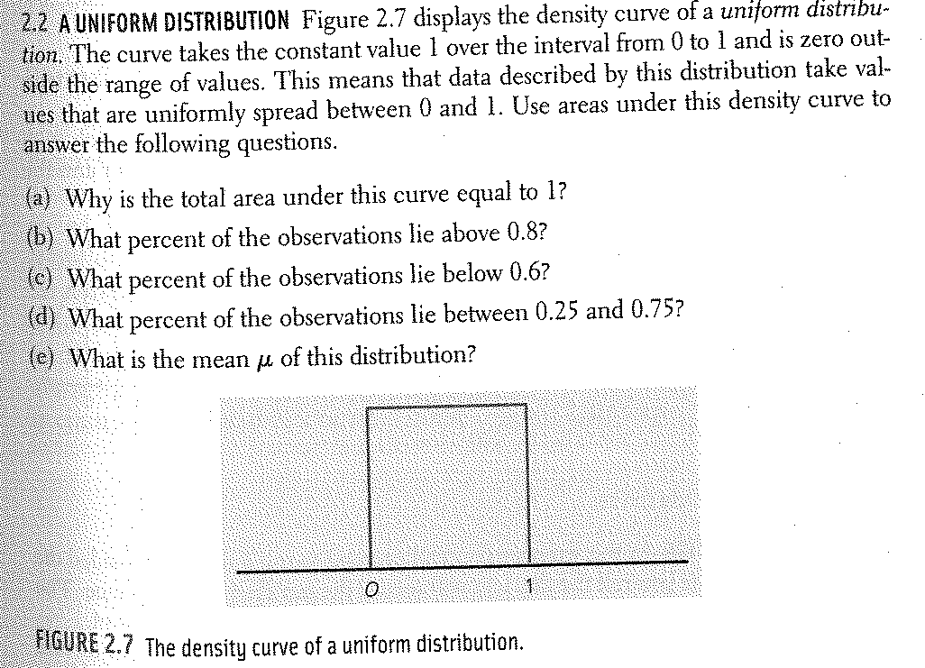
Density Curves and the Normal Distributions

Slide 14
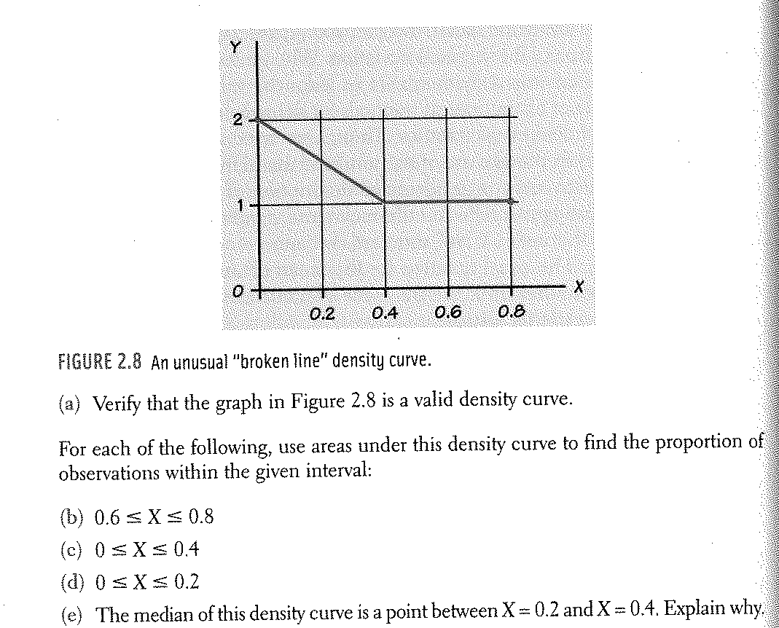
Density Curves and the Normal Distributions
Exercise 2.3

Slide 15
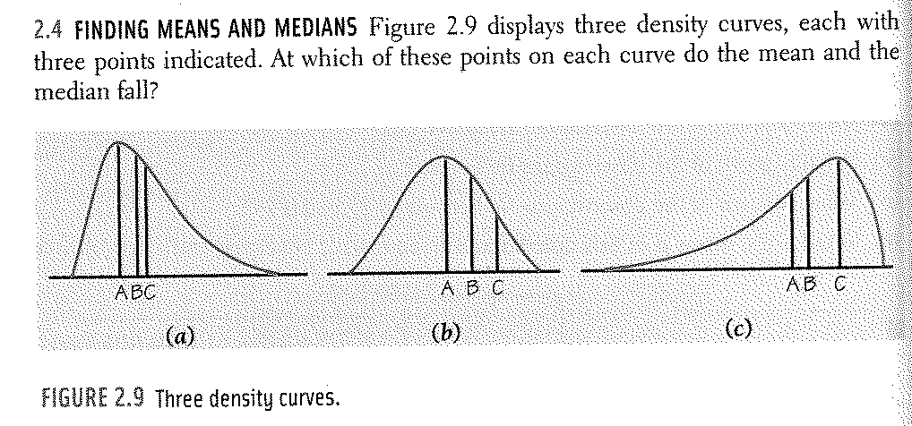
Density Curves and the Normal Distributions

Slide 16
Density Curves and the Normal Distributions
It is important to make the following distinctions in symbolism:
Actual observations
mean = $\overline{x}$ standard deviation = s
Density Curve
mean = $μ$ standard deviation = $σ$

Slide 17
Density Curves and the Normal Distributions
Normal distributions (normal curves)
Symmetric
Single-peaked
Bell-shaped
The exact density curve for a particular normal distribution is described by giving its mean and standard deviation. The mean is located at the center of the symmetric curve, and is the same as the median.

Slide 18
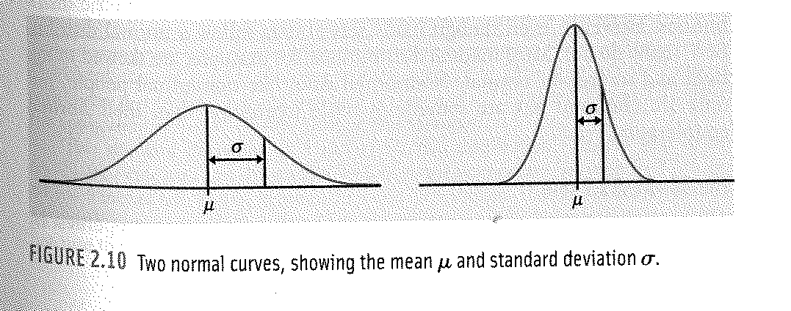
Density Curves and the Normal Distributions
Changing the mean without changing the standard deviation moves the normal curve along the horizontal axis without changing its spread. The standard deviation controls the spread of a normal curve.

Slide 19
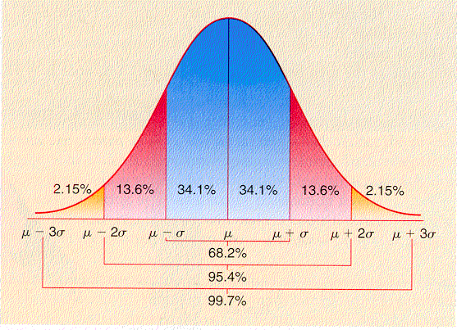
Density Curves and the Normal Distributions
Empirical Rule (68-95-99.7 Rule)
In the normal distribution with mean $μ$ and standard deviation $σ$:
68% of the observations fall within one standard deviation of the mean.
95% of the observations fall within two standard deviations of the mean.
99.7% of the observations fall within three standard deviations of the mean.

Slide 20
Density Curves and the Normal Distributions
The mean score for an IQ test is _________ with a standard deviation of ________. Find the following:
What is the range of scores that 68% of the scores will fall?
What is the range of scores that 95% of the scores will fall?
What is the range of scores that 99.7% of the scores will fall?

Slide 21
Density Curves and the Normal Distributions
What percent of the scores range from 100 to 115?
What percent of the scores are higher than 145?
What percent of the scores are lower than 130?
What percent of the scores are between 130 and 145?

Slide 22
Density Curves and the Normal Distributions
We will use a short notation N ($μ, σ)$ to abbreviate the normal distribution with mean $μ$ and standard deviation of $σ$.
National test scores are frequently reported in terms of percentiles rather than raw scores. If your score on the math portion of a test was reported as the 90th percentile, then 90% of the students who took the exam scored lower than or equal to your score. Remember the median is the 50th percentile, Q1 is the 25th percentile, and Q3 is the 75th percentile.
In the previous example about IQ scores, what is the percentile associated with a score of 115?

Slide 23
Density Curves and the Normal Distributions
Complete the exercises for Chapter 2 Section 1 except the following:
2.5, 2.10, 2.16, 2.17, 2.18

