Slide 1
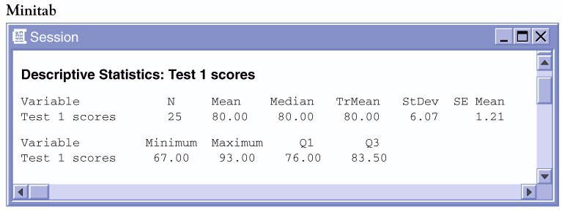

Sample Data
Consider the following test scores for a small class:
79 | 81 | 80 | 77 | 73 | 83 | 74 | 93 | 78 | 80 | 75 | 67 | 73
77 | 83 | 86 | 90 | 79 | 85 | 83 | 89 | 84 | 82 | 77 | 72
Jenny’s score is noted in red. How did she perform on this test relative to her peers?
6 | 7
7 | 2334
7 | 5777899
8 | 00123334
8 | 569
9 | 03
Her score is “above average”...
but how far above average is it?

Slide 2
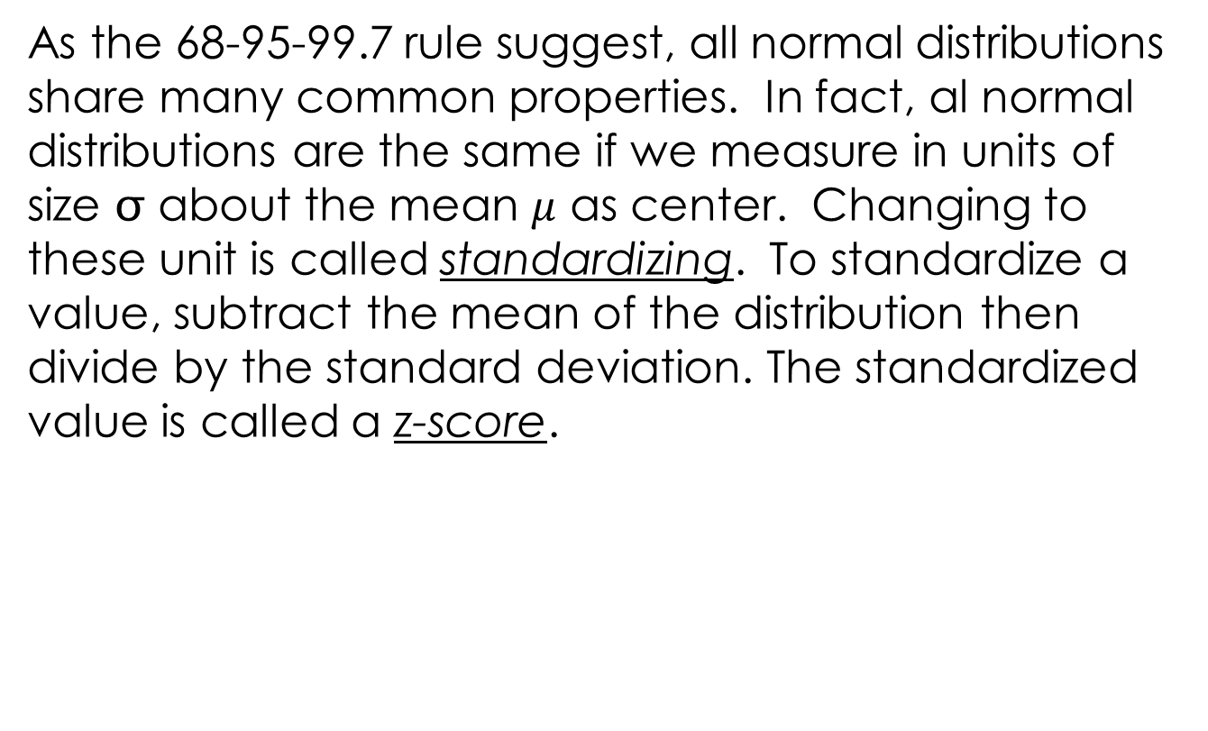
Section 2.2
As the 68-95-99.7 rule suggest, all normal distributions share many common properties. In fact, al normal distributions are the same if we measure in units of size  about the mean $μ$ as center. Changing to these unit is called standardizing. To standardize a value, subtract the mean of the distribution then divide by the standard deviation. The standardized value is called a z-score.

Slide 3
Standardized Value
One way to describe relative position in a data set is to tell how many standard deviations above or below the mean the observation is.
Standardized Value: “z-score”
If the mean and standard deviation of a distribution are known, the “z-score” of a particular observation, x, is:

Slide 4
Calculating z-scores
Consider the test data and Julia’s score.
79 | 81 | 80 | 77 | 73 | 83 | 74 | 93 | 78 | 80 | 75 | 67 | 73
77 | 83 | 86 | 90 | 79 | 85 | 83 | 89 | 84 | 82 | 77 | 72
According to Minitab, the mean test score was 80 while the standard deviation was 6.07 points.
Julia’s score was above average. Her standardized z-score is:
Julia’s score was almost one full standard deviation above the mean.
What about Kevin: x= 72??

Slide 5
Calculating z-scores
79 | 81 | 80 | 77 | 73 | 83 | 74 | 93 | 78 | 80 | 75 | 67 | 73
77 | 83 | 86 | 90 | 79 | 85 | 83 | 89 | 84 | 82 | 77 | 72
Julia: z=(86-80)/6.07
z= 0.99
{above average = +z}
6 | 7
7 | 2334
7 | 5777899
8 | 00123334
8 | 569
9 | 03
Kevin: z=(72-80)/6.07
z= -1.32
{below average = -z}
Katie: z=(80-80)/6.07
z= 0
{average z = 0}

Slide 6

Comparing Scores
Standardized values can be used to compare scores from two different distributions.
  Statistics Test: mean = 80, std dev = 6.07
  Chemistry Test: mean = 76, std dev = 4
  Jenny got an 86 in Statistics and 82 in Chemistry.
  On which test did she perform better?
Statistics
Chemistry
Although she had a lower score, she performed relatively better in Chemistry.

Slide 7
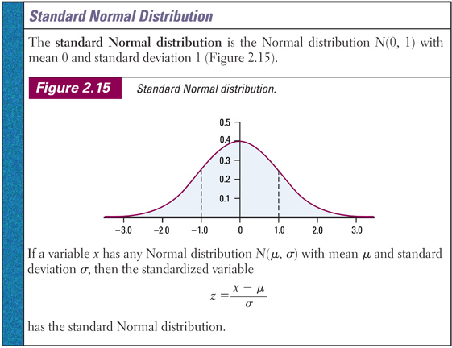

Slide 8
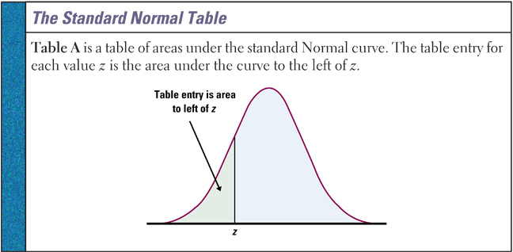
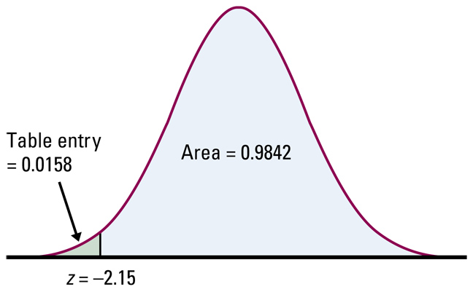
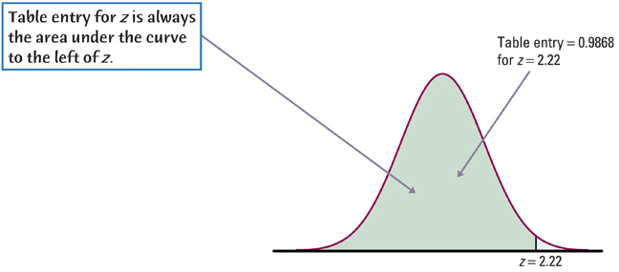
Normal Distribution Calculations

Slide 9
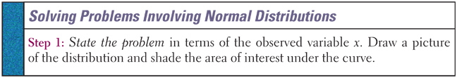
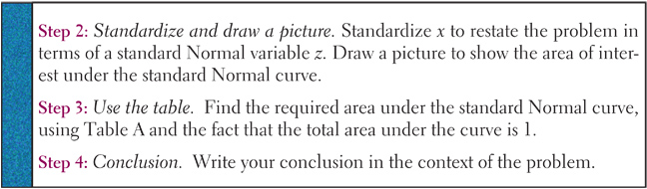
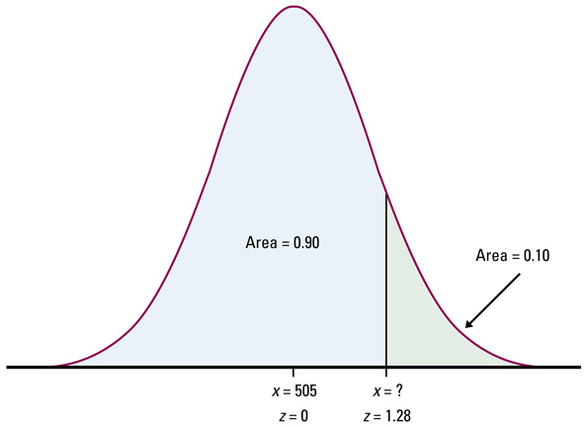

Slide 10
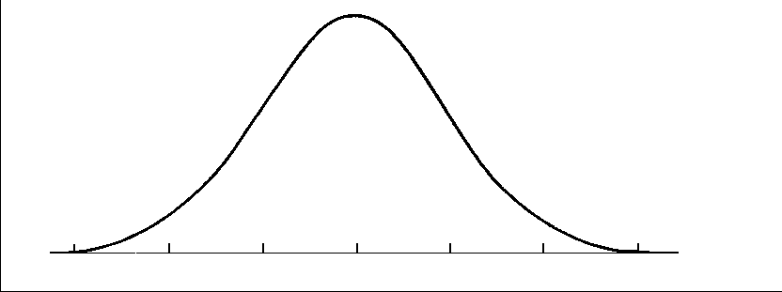
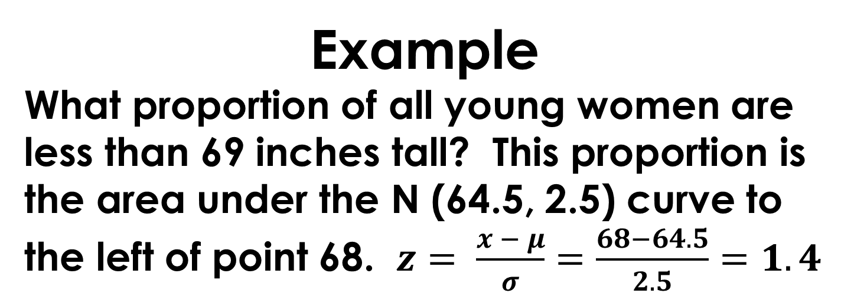
Example
What proportion of all young women are less than 69 inches tall? This proportion is the area under the N (64.5, 2.5) curve to the left of point 68. $z= \frac{x − μ}{σ}=\frac{68−64.5}{2.5}=1.4$

Slide 11
Example
What proportion of all young women are taller than 65 inches?

Slide 12
Example
What proportion of all young women between 65 and 68 inches?

Slide 13
Example
How tall would a young women be if she was in the 40th percentile (meaning 40% of all young women are at or below her height)?

Slide 14
Assessing Normality
Later in this course, we will want to invoke various tests of significance to try to answer questions that are important to us. These test involve sampling people or objects and inspecting them carefully to gain insights into the populations from which they come. Many of these procedures are based on the assumption that the host population is normally distributed. So, we need to develop methods for assessing normality.

Slide 15
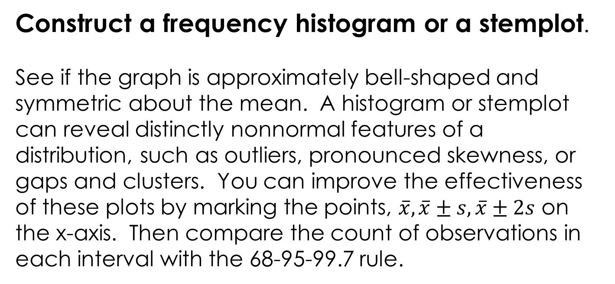
Method One
Construct a frequency histogram or a stemplot.
See if the graph is approximately bell-shaped and symmetric about the mean. A histogram or stemplot can reveal distinctly nonnormal features of a distribution, such as outliers, pronounced skewness, or gaps and clusters. You can improve the effectiveness of these plots by marking the points, $\overline{x}, \overline{x}±s, \overline{x}±2s$ on the x-axis. Then compare the count of observations in each interval with the 68-95-99.7 rule.

Slide 16
Method Two
Construct a normal probability plot. A normal probability plot provides a good assessment of the adequacy of the normal model for a set of data. The graphing calculator will do normal probability plots. You will need to be able to produce a normal probability plot (either with a calculator or with statistical software) and interpret it.

Slide 17
Exercise 2.26 from text
Repeated careful measurements of the same physical quantity often have a distribution that is close to normal. Here are Henry Cavendish’s 29 measurements of the density of the earth, make in 1798.
5.50 | 5.61 | 4.88 | 5.07 | 5.26 | 5.55 | 5.36 | 5.29 | 5.58 | 5.65
5.57 | 5.53 | 5.62 | 5.29 | 5.44 | 5.34 | 5.79 | 5.10 | 5.27 | 5.39
5.42 | 5.47 | 5.63 | 5.34 | 5.46 | 5.30 | 5.75 | 5.68 | 5.85

Slide 18
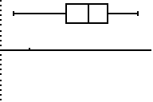
Exercise 2.26 from text
a. Construct a stemplot to show the data are reasonably symmetric.
48
49
50
51
52
53
54
55
56
57
58

Slide 19

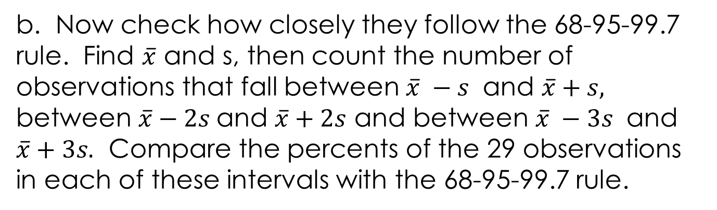
Exercise 2.26 from text
b. Now check how closely they follow the 68-95-99.7 rule. Find $\overline{x}$ and s, then count the number of observations that fall between $\overline{x} −s$ and $\overline{x}+s,$ between $\overline{x}−2s$and $\overline{x}+2s$ and between $\overline{x} −3s$ and $\overline{x}+3s.$ Compare the percents of the 29 observations in each of these intervals with the 68-95-99.7 rule.
$$\overline{x}$$

Slide 20
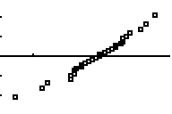
Exercise 2.26 from text
c. Use your calculator to construct a normal probability plot for Cavendish’s density of the earth data, and write a brief statement about the normality of the data. Does the normal probability plot reinforce your findings in a?
Enter your data in L₁ . Choose 2nd Statplot and turn Statplot 1 On. Choose the last graph option for normal probability plot.
The linearity of the normal probability plot indicates an approximately normal distribution.

