Slide 1
Unit 3 Examining Relationships
Introduction
Scatterplots
Correlation
Least-Squares Regression

Slide 2
In this chapter we will concentrate on relationships among several variable instead of a single variable.
When you examine the relationship between two or more variable, first ask the preliminary questions that are familiar from the previous chapters.
What individuals do the data describe?
What exactly are the variables? How are they measured?
Are all the variables quantitative or is at least one a categorical variable?
Do you want to simply explore the nature of the relationship, or do you think that some of the variables explain or even cause changes in others? That is, are some of the variables response variables and others explanatory variables?

Slide 3
A response variable measures an outcome of a study. (Dependent Variables)
An explanatory variable attempts to explain the observed outcomes. ( Independent Variables)

Slide 4
Example)
Alcohol has many effects on the body. One effect is a drop in body temperature. To study this effect, researchers give several different amounts of alcohol to mice, then measure the change in each mouse’s body temperature in the 15 minutes after taking the alcohol. Amount of alcohol is the explanatory variable, and changes in the body temperature is the response variable.

Slide 5
Example)
Jim wants to know how the median SAT Math and Verbal scores in the 51 states (including the District of Columbia) are related to each other. He doesn’t think that either score explains or causes the other. Jim has two related variables, and neither is an explanatory variable.
Julie looks at some data. She asks, “ Can I predict a state’s median SAT Math score if I know its median SAT Verbal score?” Julie is treating the Verbal score as the explanatory variable and the Math score as the response variable.

Slide 6
The principles that guide examination of data are still the same for bivariate data:
First plot the data, then add numerical summaries.
Look for an overall pattern and deviations from those patterns.
When the overall pattern is quite regular, use a compact mathematical model to describe it.

Slide 7
Exercises 3.1-3.5 page 122-123

Slide 8
Scatterplots
The most effective way to display the relation between two quantitative variables is a scatterplot.

Slide 9
A scatterplot shows the relationship between two quantitative variables measured on the same individuals. The values of one variable appear on the horizontal axis, and the values of the other appear on the vertical axis. Each individual in the data appears as the point in the plot fixed by the values of both variables for that individual.

Slide 10
Tips for drawing scatterplots
Scale the horizontal and vertical axes. The intervals must be uniform. If the scale does not begin at zero at the origin, then use the appropriate symbol to indicate a break.
Label both axes. Not just x and y.
If you are given a grid, try to adopt a scale so that your plot uses the whole grid. Make your plot large enough so that the details can be easily seen. Don’t compress the plot into one corner of the grid.

Slide 11
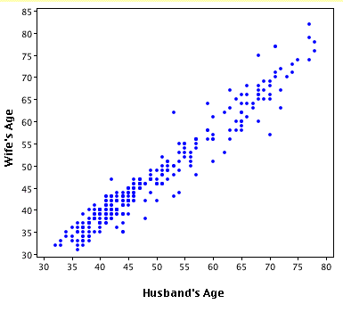

Slide 12
Interpreting scatterplots
In any graph of data, look for the overall pattern and for striking deviations from that pattern.
You can describe the overall pattern of a scatterplot by the form, direction, and strength of the relationship.
An important kind of deviation is an outlier, an individual value that falls outside the overall pattern of the relationship.

Slide 13
Refer to Figure 3.1 on page 124
Form: There are two distinct clusters of states wit a gap between them. In the cluster at the right of the plot, 45% or more of high school graduates take the SAT, and the average scores are low. The states that cluster to the left have higher SAT scores and lower percents of graduates taking the test. There are no clear outliers.

Slide 14
What explains the clusters? There are two widely used college entrance exams, the SAT and ACT. Each state favors one or the other. The left cluster contains the ACT states, and the SAT states make up the right cluster. In ACT states, most students who take the SAT are applying to a selective college that requires SAT scores. This select group of students has a higher average score than the much larger group of students who take the SAT in SAT states.

Slide 15
Direction: States in which a higher percent of students take the SAT tend to have lower average scores. This is a negative association between the two variables.
Strength: The strength of a relationship in a scatterplot is determined by how closely the points follow a clear form. The overall relationship in Figure 3.1 is not strong—states with similar percents taking the SAT show quite a bit of scatter in their average scores.

Slide 16
Describe the form, direction, and strength of the relationship to the left between husband’s ages and wife’s ages. Can you explain the relationship?

Slide 17
Adding Categorical Variables to Scatterplots

Slide 18
Correlation
A scatterplot displays direction, form and strength of the relationship between two quantitative variables. Linear relations are particularly important because a straight line is a simple pattern that is quite common. We say the relationship is strong if the points lie close to a straight line. The relationship is weaker the more spread out from a line the points are.

Slide 19
Our eyes are not good judges of how strong this relationship is. Below are two scatterplots of the same data. Discuss the differences you see.

Slide 20
You can see our eyes can be fooled just by changing the scales. We need to follow our strategy for data analysis by using a numerical measure to supplement the graph. Correlation is the measure we use.
The correlation measures the direction and strength of the linear relationship between two quantitative variables. Correlation is usually written as r.

Slide 21
Correlation
Explain whether a scatterplot for each pair of variables would probably show a positive, negative, or no correlation between the variables.
your age and weight from ages 1 to 20
temperature of a cup of coffee and the time it sits on the table
The amount a mail carrier earns each day and the weight of the mail delivered each day
The distance traveled and the time driving
a person’s height and their birth month
the amount of snow on the ground and the daily temperature
the time water boils and the amount of water in the pot
the number of files stored on a disk and the amount of memory left on the disk.

Slide 22
Linear Correlation Coefficient
1. Over the past 10 years, there has been a high positive correlation between the number of South Dakota safety inspection stickers issued and the number of South Dakota traffic accidents.
a. Do safety inspection stickers cause traffic accidents?
b. What third factor might cause traffic accidents and the number of safety stickers to increase together?
2. There is a high positive correlation in the United States between teacher’s salaries and annual consumption of liquor.
a. Do you think increasing teacher’s salaries has caused increased liquor consumption?
b. As teacher’s salaries have been going up, most other salaries have been going up too. To some extent this means an upward trend in buying power for everyone. How might this explain the high correlation between teacher’s salaries and liquor consumption?

Slide 23
3. Over the past 30 years in the United States there has been a strong negative correlation between number of infant deaths at birth and number of people over age 65.
a. Is the fact that people are living longer causing a decrease in infant mortalities at birth?
b. What third factor might be decreasing infant mortalities and at the same time increasing life span?
4. Over the past few years, there has been a strong positive correlation between annual consumption of diet soda pop and the number of traffic accidents.
a. Do you think that an increasing consumption of diet pop has led to more traffic accidents?
b. What third factor or factors might be causing both the annual consumption of diet pop and the number of traffic accidents to increase together?

Slide 24
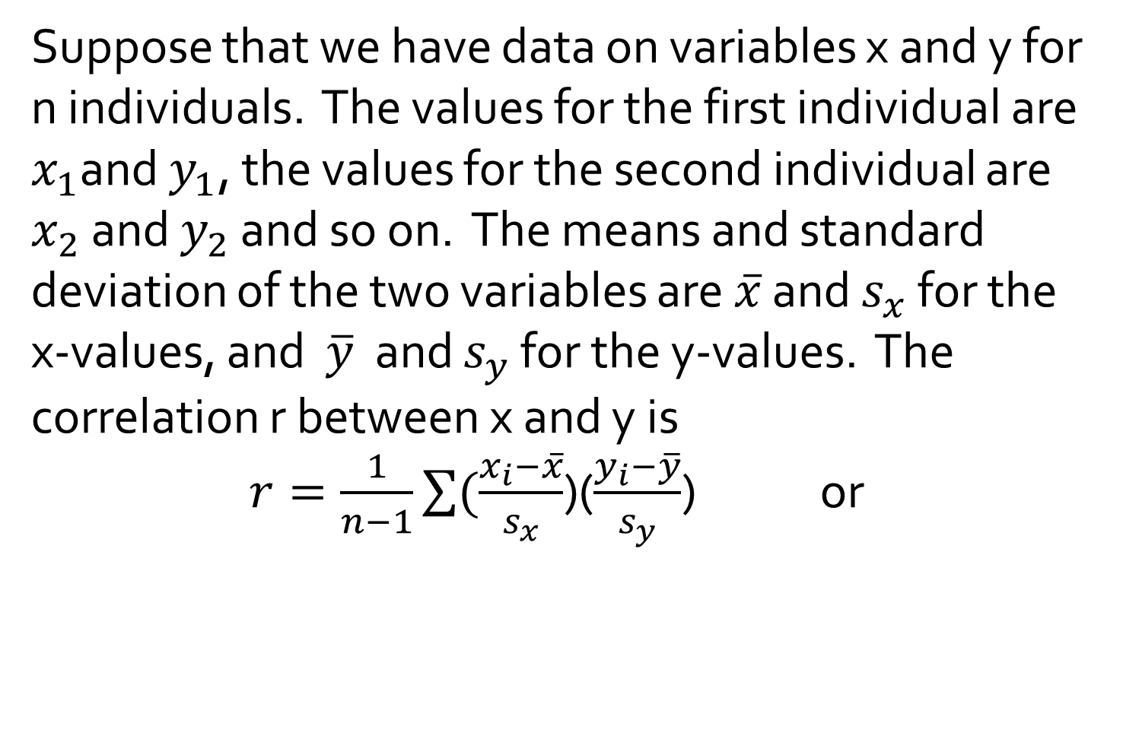
Suppose that we have data on variables x and y for n individuals. The values for the first individual are $x_{1}$and $y_{1}$, the values for the second individual are $x_{2}$ and $y_{2}$ and so on. The means and standard deviation of the two variables are $\overline{x}$ and $s_{x}$ for the x-values, and $\overline{y}$ and $s_{y}$ for the y-values. The correlation r between x and y is
$r=\frac{1}{n−1}\sum{(\frac{x_{i}−\overline{x}}{s_{x}}}$)($\frac{y_{i}−\overline{y}}{s_{y}}$) or

Slide 25
Facts about correlation
1. Correlation makes no distinction between explanatory and response variables. It makes no difference which variable you call x and which you call y in calculating the correlation.

Slide 26
Facts about correlation
2. Correlation requires that both variables are quantitative, so that it makes sense to do the arithmetic indicated by the formula r. We cannot calculate a correlation between the incomes of a group of people and what city they live in because the city is a categorical variable.

Slide 27
Facts about correlation
3. Because r used the standardized values of the observations, r does not change when we change the units of measurement of x, y, or both. Measuring height in inches rather than centimeters and weight in pounds rather than kilograms does not change the correlation between height and weight. The correlation r itself has no unit of measurement; it is just a number.

Slide 28
Facts about correlation
4. Positive r indicates positive association between the variables, and negative r indicates a negative association.

Slide 29
Facts about correlation
5. The correlation r is always a number between -1 and 1. Values of r near 0 indicate a very week linear relationship. The strength of the linear relationship increases as r moves away from 0. Values of r close to -1 or 1 indicate the points of the scatterplot lie close to a straight line.

Slide 30
Facts about correlation
6. Correlation measures the strength of only a linear relationship between two variables. Correlation does not describe curved relationships between variables, no matter how strong they are.

Slide 31
Facts about correlation
7. Like the mean and standard deviation, the correlation is not resistant; r is strongly affected by a few outlying observations. Use r with caution when outliers appear in the scatterplot.

Slide 32
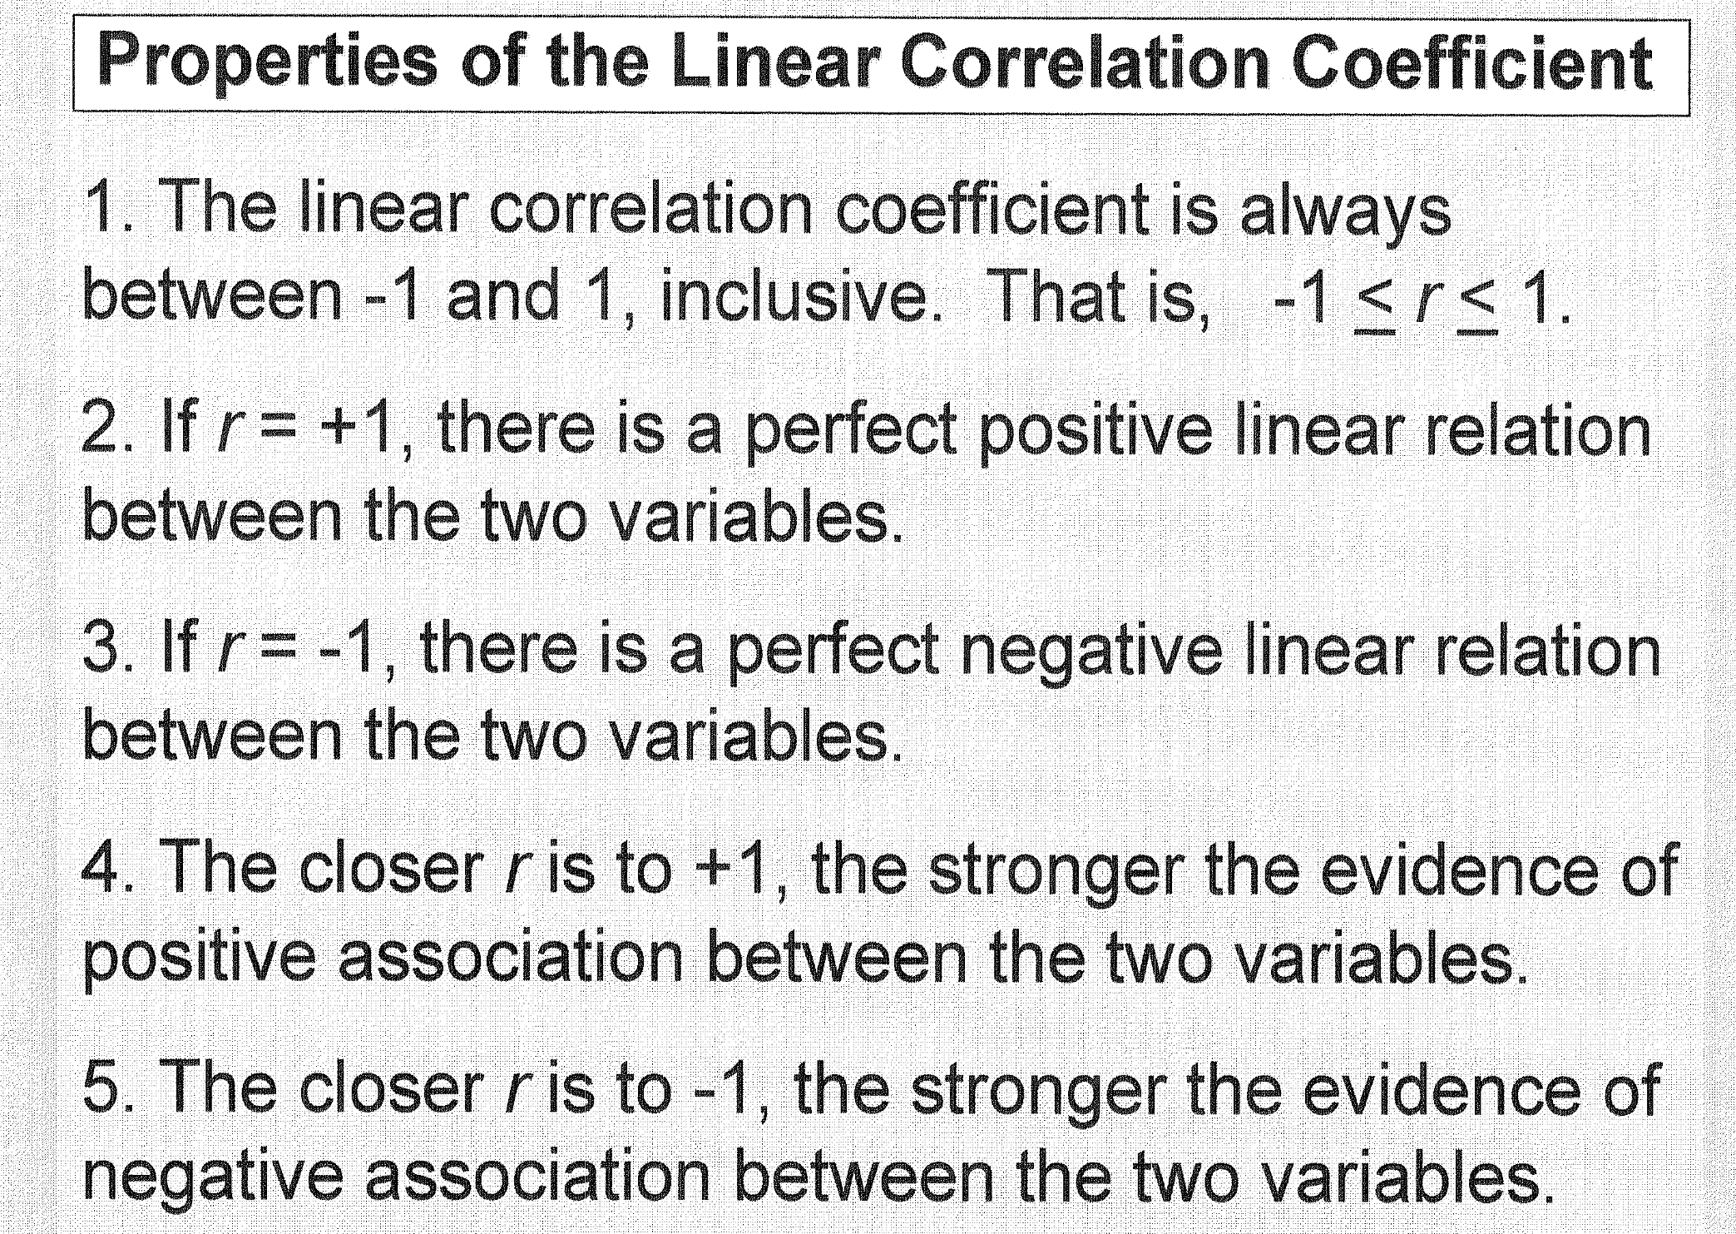

Slide 39
Least-Squares Regression
Correlation measures the strength and direction of the linear relationship between two quantitative variables. If a scatterplot shows a linear relationship, we would like to summarize this overall pattern with a model of the data (a straight line). Least-squares regression is a method for finding a line that summarizes the relationship between the two variables.

Slide 40
Regression Line
A regression line is a straight line that describes how a response variable y changes as an explanatory variable x changes. We often use a regression line to predict the value of y for a given value of x. Regression requires that we have an explanatory variable and a response variable.

Slide 41
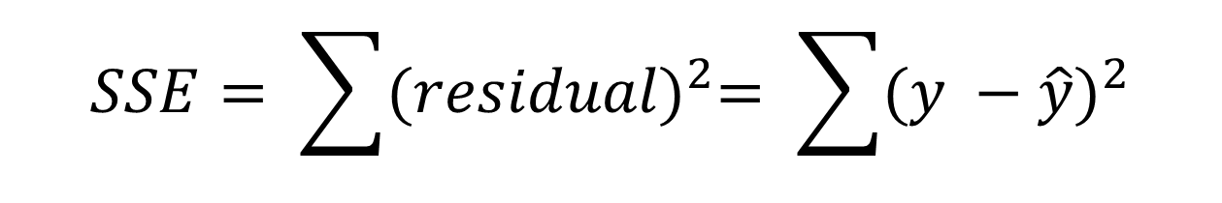
Least Squares Regression Line
The general approach to fitting lines to data is called the method of least squares. The least squares line or regression line, for a set of data points (x, y) is the line for which the sum of squared errors (residuals), or SSE, is as small as possible.
$$SSE= \sum{{(residual)}^{2}= \sum{{(y −\hat{y})}^{2}}}$$

Slide 42
Residuals

Slide 43
Squared Residuals

Slide 44
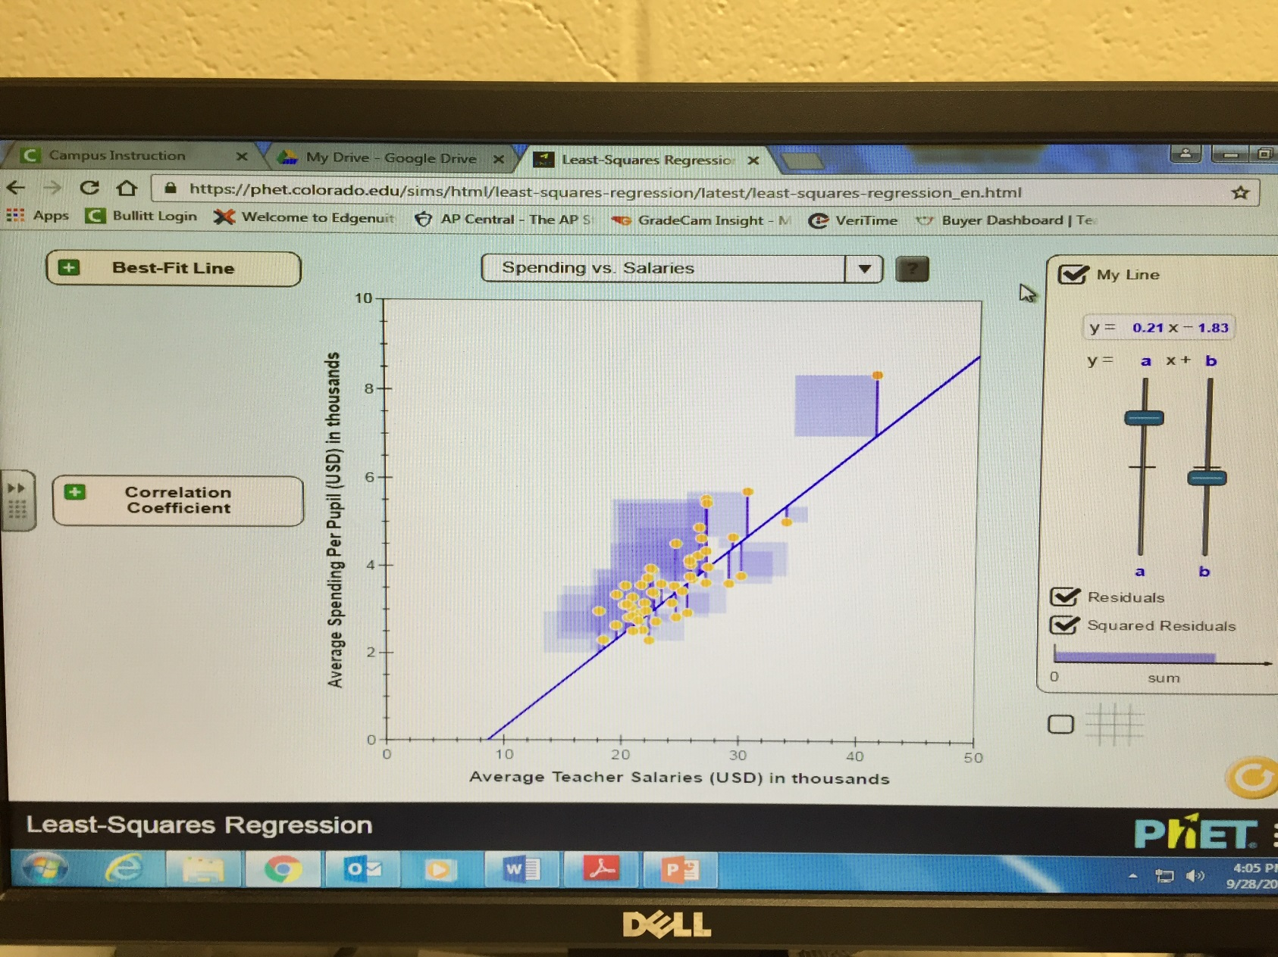
https://phet.colorado.edu/sims/html/least-squares-regression/latest/least-squares-regression_en.html

Slide 45
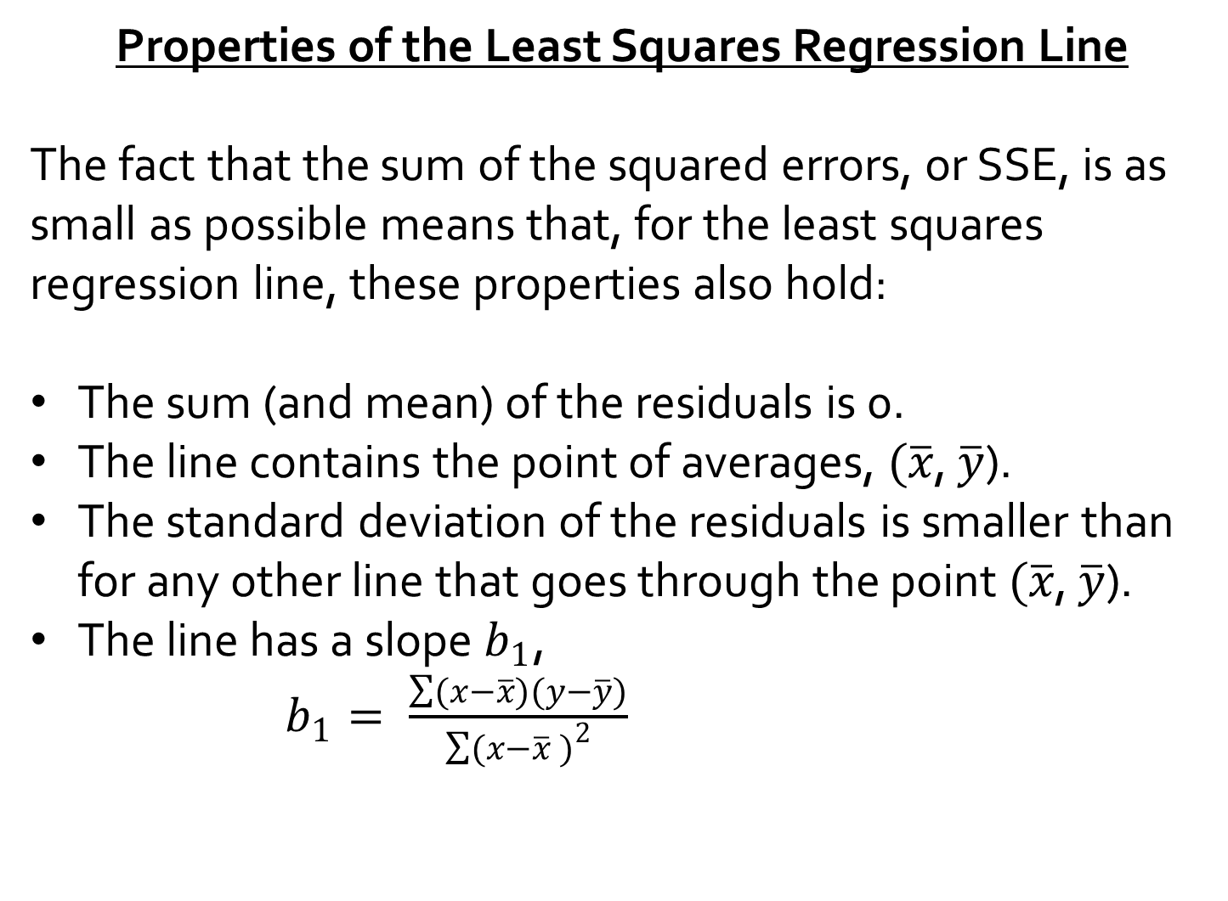
Properties of the Least Squares Regression Line
The fact that the sum of the squared errors, or SSE, is as small as possible means that, for the least squares regression line, these properties also hold:
The sum (and mean) of the residuals is 0.
The line contains the point of averages, $(\overline{x}$, $\overline{y}$).
The standard deviation of the residuals is smaller than for any other line that goes through the point $(\overline{x}$, $\overline{y}$).
The line has a slope $b_{1}$,
$b_{1}= \frac{\sum{(x−\overline{x})(y−\overline{y})}}{\sum{(x−\overline{x}} )^{2}}$

Slide 46
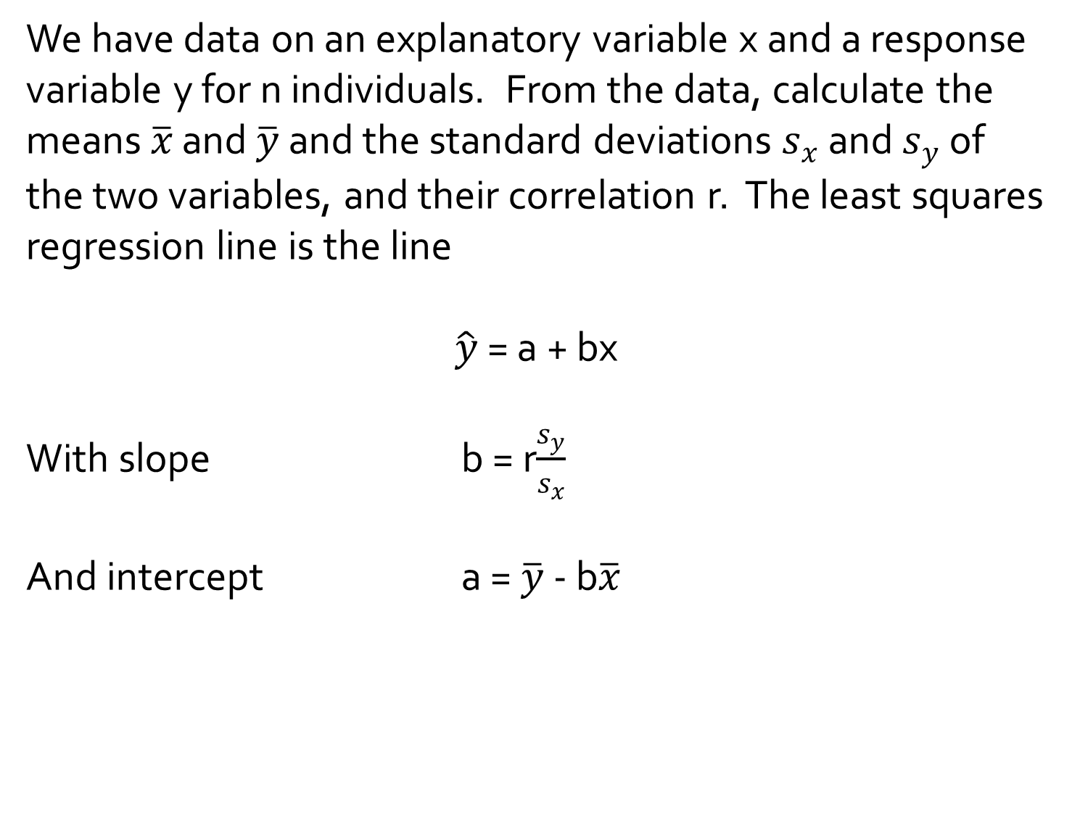
Equation of the Least-Squares Regression Line
We have data on an explanatory variable x and a response variable y for n individuals. From the data, calculate the means $\overline{x}$ and $\overline{y}$ and the standard deviations $s_{x}$ and $s_{y}$ of the two variables, and their correlation r. The least squares regression line is the line
$\hat{y}$ = a + bx
With slope b = r$\frac{s_{y}}{s_{x}}$
And intercept a = $\overline{y}$ - b$\overline{x}$

Slide 47
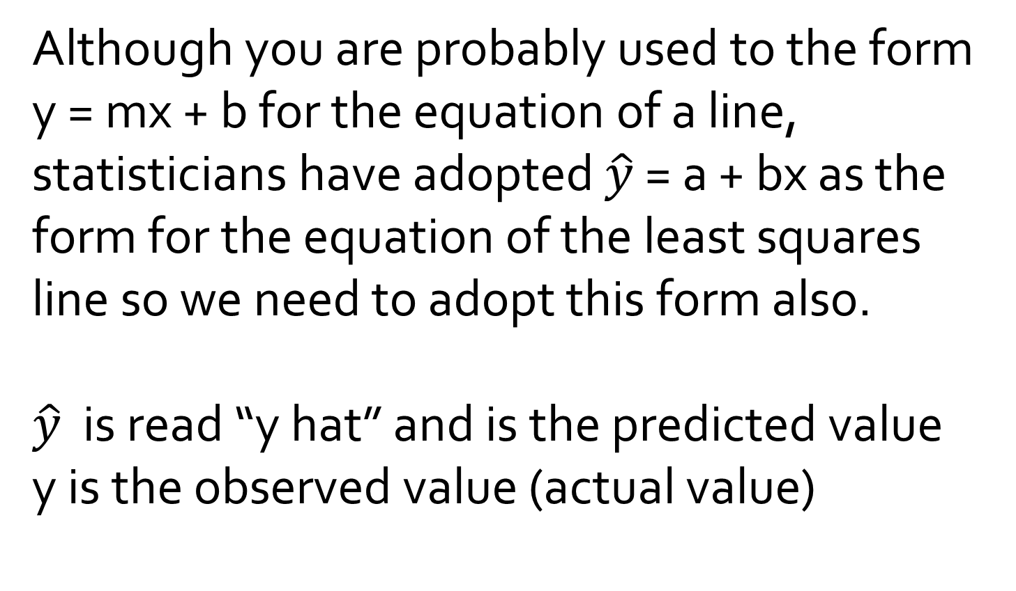
Equation of the Least-Squares Regression Line
Although you are probably used to the form y = mx + b for the equation of a line, statisticians have adopted $\hat{y}$ = a + bx as the form for the equation of the least squares line so we need to adopt this form also.
$\hat{y}$ is read “y hat” and is the predicted value
y is the observed value (actual value)

Slide 48
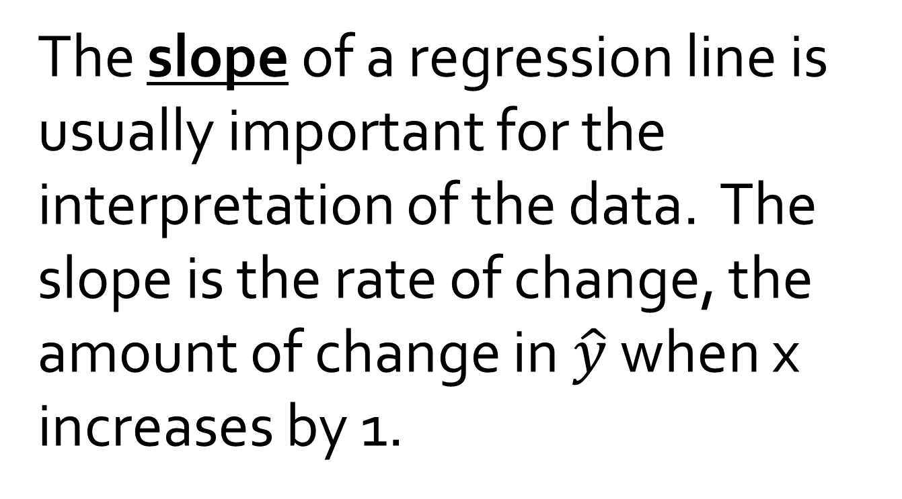
Slope
The slope of a regression line is usually important for the interpretation of the data. The slope is the rate of change, the amount of change in $\hat{y}$ when x increases by 1.

Slide 49
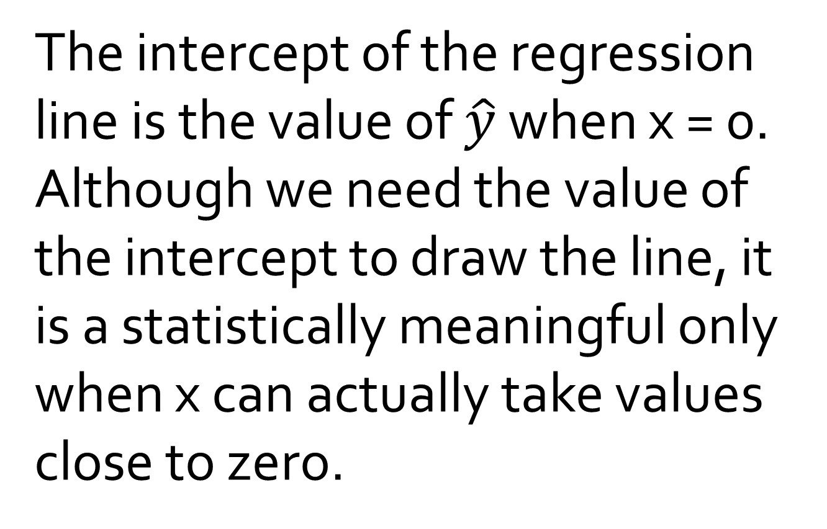
Intercept
The intercept of the regression line is the value of $\hat{y}$ when x = 0. Although we need the value of the intercept to draw the line, it is a statistically meaningful only when x can actually take values close to zero.

Slide 50
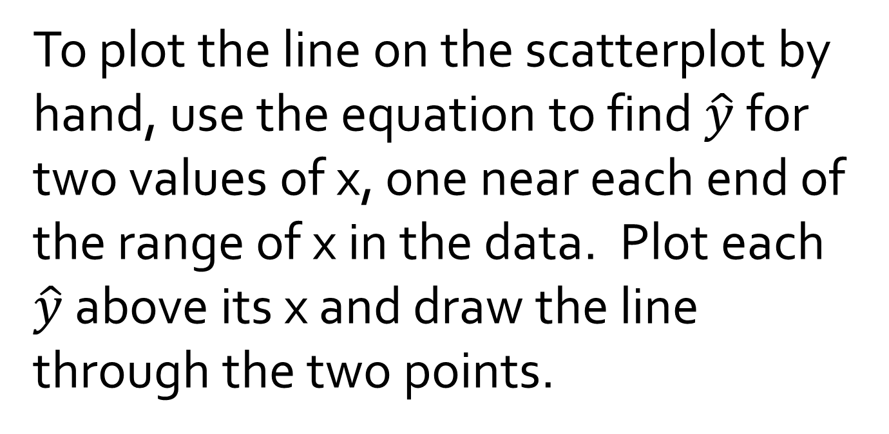
Plotting the Least-Squares Line
To plot the line on the scatterplot by hand, use the equation to find $\hat{y}$ for two values of x, one near each end of the range of x in the data. Plot each $\hat{y}$ above its x and draw the line through the two points.

Slide 51
The role of r² in regression
r² is called the coefficient of determination and is interpreted as the proportion of the total sample variability that is explained by the least-squares regression line of y on x.
Example: When r²= 0.357, we say that 35.7% of the variation in y is explained by the least-squares regression of y on x.

Slide 52
Facts about Least-Squares Regression
1. The distinction between explanatory and response variables is essential in regression.

Slide 53
Facts about Least-Squares Regression
2. There is a close connection between the correlation and the slope.

Slide 54
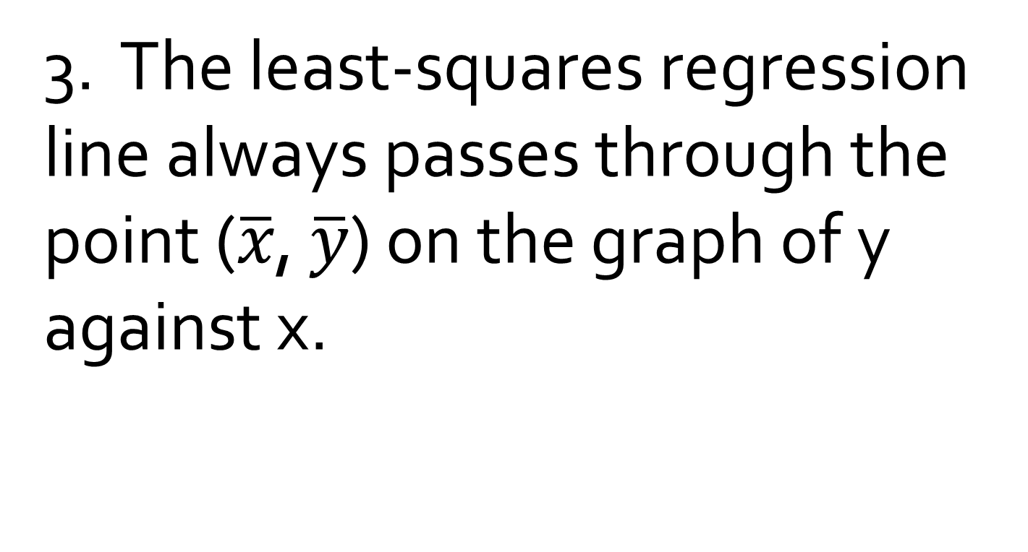
Facts about Least-Squares Regression
3. The least-squares regression line always passes through the point ($\overline{x}$, $\overline{y}$) on the graph of y against x.

Slide 55
Facts about Least-Squares Regression
4. The square of the correlation, r², is the fraction of the variation in the values of y that is explained by the least-squares regression of y on x.

